Slide 1


CS 235: User Interface Design January 29 Class Meeting
Department of Computer Science San Jose State University Spring 2015 Instructor: Ron Mak
www.cs.sjsu.edu/~mak

Slide 2
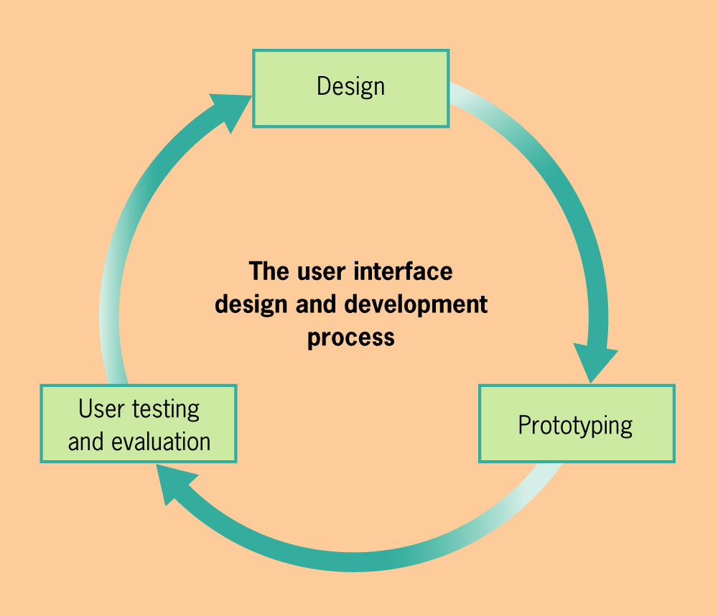
Preliminaries
Purpose of the application
User-centered design
Understand the users
Iterative design
User Interface Design & Evaluation
Debbie Stone, et al.
Morgan Kaufman, 2005

Slide 3
Functional Requirements
What the application shall be able to do or allow users to do.
“The phone shall use GPS to determine the wearer’s location.”
“Users shall be able to choose either Option A or Option B.”
Describe the interactions between the user and the application, independent of the implementation.

Slide 4
Nonfunctional Requirements
Usability, reliability, performance, supportability, etc.
“The application must respond to the user within 15 seconds.”
“The application must run on Windows and Linux servers.”
“The new GUI shall resemble the existing GUI.”
Constraints that the application must meet.

Slide 5
Parts of a Use Case
Name
The name should be in the form verb object.
Goal
What does this task accomplish?
Sequence of steps
For each step:
What is the user action?
What is the application’s response?
Include any alternate sequences in case something goes wrong during a step.

Slide 6
Functional Specification
Name of the application
A short description
What is the purpose of your application?
1 paragraph
How will it accomplish this purpose?
1 to 3 paragraphs
List of functional requirements
List of nonfunctional requirements
Use cases

Slide 7
Initial Interviews
Design Team | Client Team/App
Unknown | Innovative Designers Team Collaboration
Innovative Designers | Team Four Contact Management
Team Four | Thundercats Online Banking
Thundercats | Uxability To-Do List
Uxability | XFactor Online multilingual IDE
XFactor | Unknown Airline Scheduling
Initial interviews: design team ➔ client team
Round 1
Unknown ➔ Innovative Designers
Team Four ➔ Thundercats
Uxability ➔ XFactor
Round 2
Innovative Designers ➔ Team Four
Thundercats ➔ Uxability
XFactor ➔ Unknown
25 minutes per round

Slide 8
Assignment #1
Continue to interview your client team.
Create a Functional Specification (first draft)
Application name
Application description
List of at least 10 functional requirements
List of at least 4 nonfunctional requirements
At least 5 use cases _

Slide 9
Assignment #1, cont’d
Each team turns in one Functional Specification.
Microsoft Word document or PDF
Email as an attachment to ron.mak@sjsu.edu
Subject: CS 235 Assignment #1 Team name
Be sure to CC all team members
Due Friday, February 6 at 11:59 PM.

